Slide 1
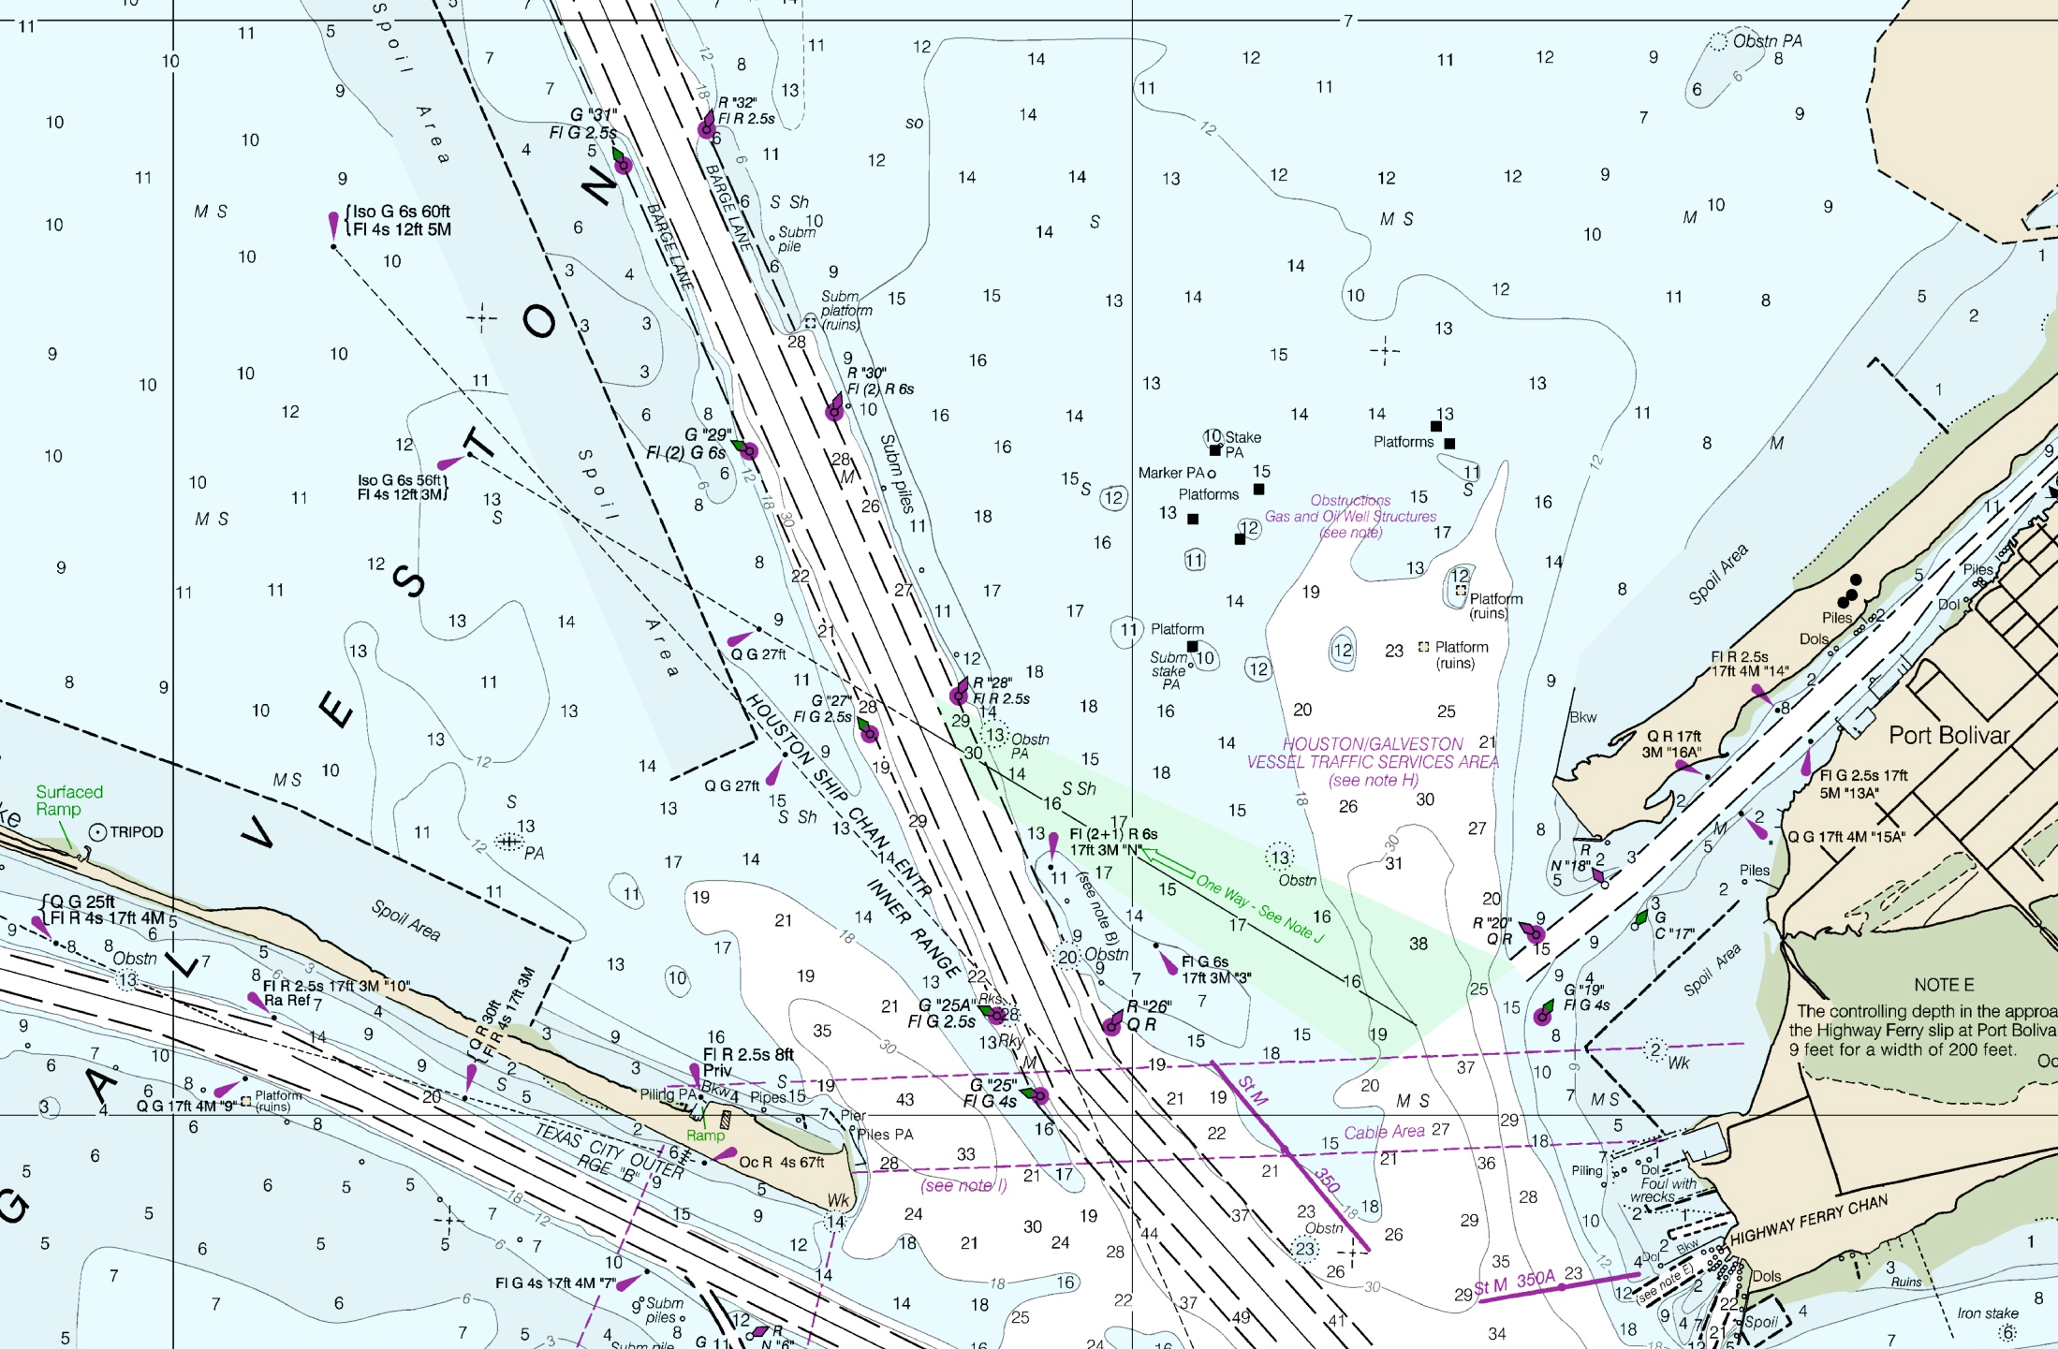
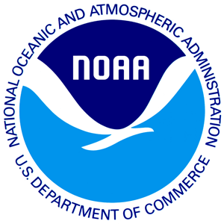
Overview of Coast Survey’s Unmanned System Activities & Strategy

Slide 2
Coast Survey’s Unmanned Systems Experience
Began Small AUV Evaluation
Began
Bathy AUV Evaluation
Safe Seas Demo
Bathy AUV Testing (Hassler)
Saildrone Dataset
Vieques UXO Survey
Interdisciplinary Surveys (Shimada)
Arctic USV Survey
2004
2005
2006
2007
2008
2009
2010
2011
2012
2013
2014
2015
2016
2017
2018
FKNMS Survey
Hurricane Ike Response
CTD AUV
Testing
Small USVs (TJ)
AHSL Conversion
USV Charter (Nancy Foster)
Emergency Response AUV Team Formalized
NRT1 UxS Team

Slide 3
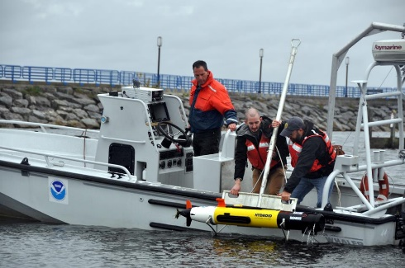
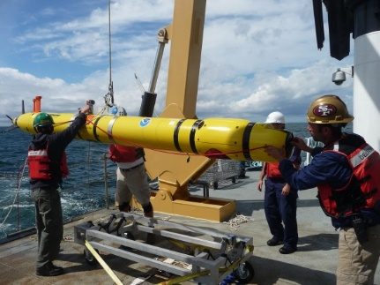
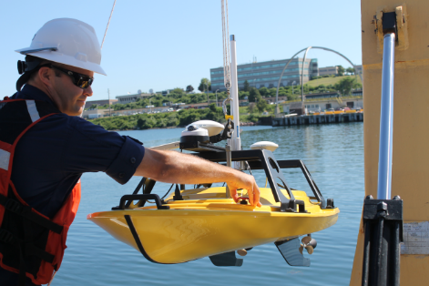
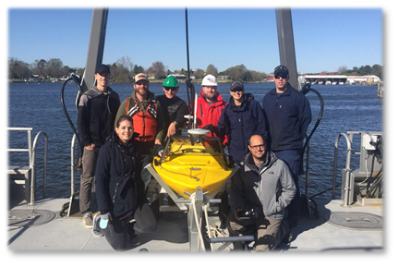
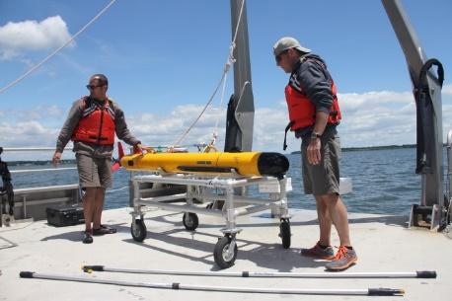
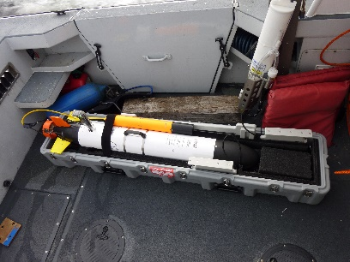
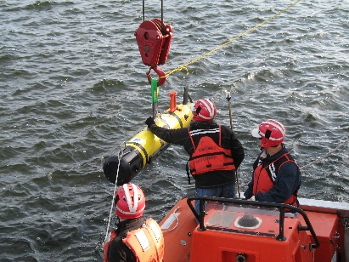
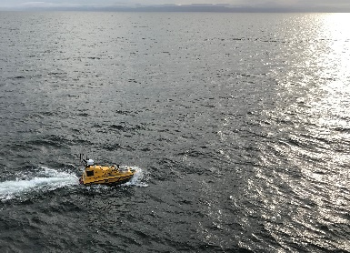
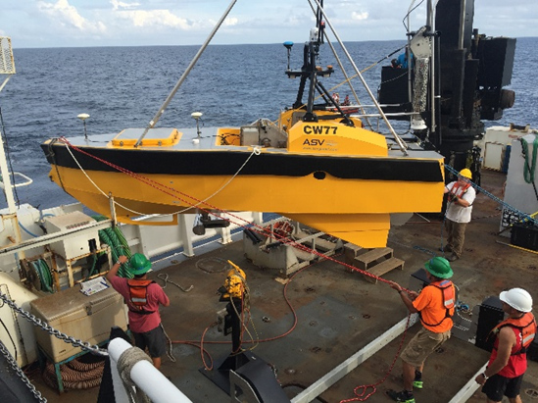
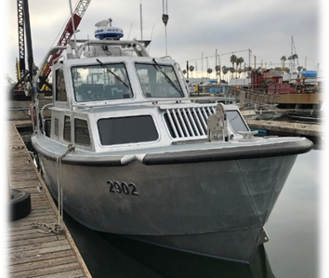
Coast Survey’s Unmanned Systems In Operation or Evaluated
Currently Owned Systems (Located with NRT1 – Stennis, MS)
Hydroid REMUS-100
Hydroid REMUS-600
Teledyne Oceanscience Z-Boat (2)
Seafloor Systems Echoboat (2)
Previously Owned Systems
VCT Harborscan (Retired)
OceanServer Iver (Transferred)
REMUS-600 (Lost)
Collaborative Systems
Multi-Use Systems
ASV C-Worker 4
(UNH CCOM/JHC)
ASV C-Worker 5
(USM)
Optionally-manned Survey Launch
(NOAA Ship Rainier)
Notes:
Previously Owned Systems
VCT – Retired due to manufacturer’s inability to continue support
Ocean Server Iver – Transferred to NMFS Southeast Fisheries Science Center
REMUS-600 – Lost in New London, CT during port security survey with NOAA Ship Thomas Jefferson. Likely struck and sunk by commercial traffic (ferry)

Slide 4
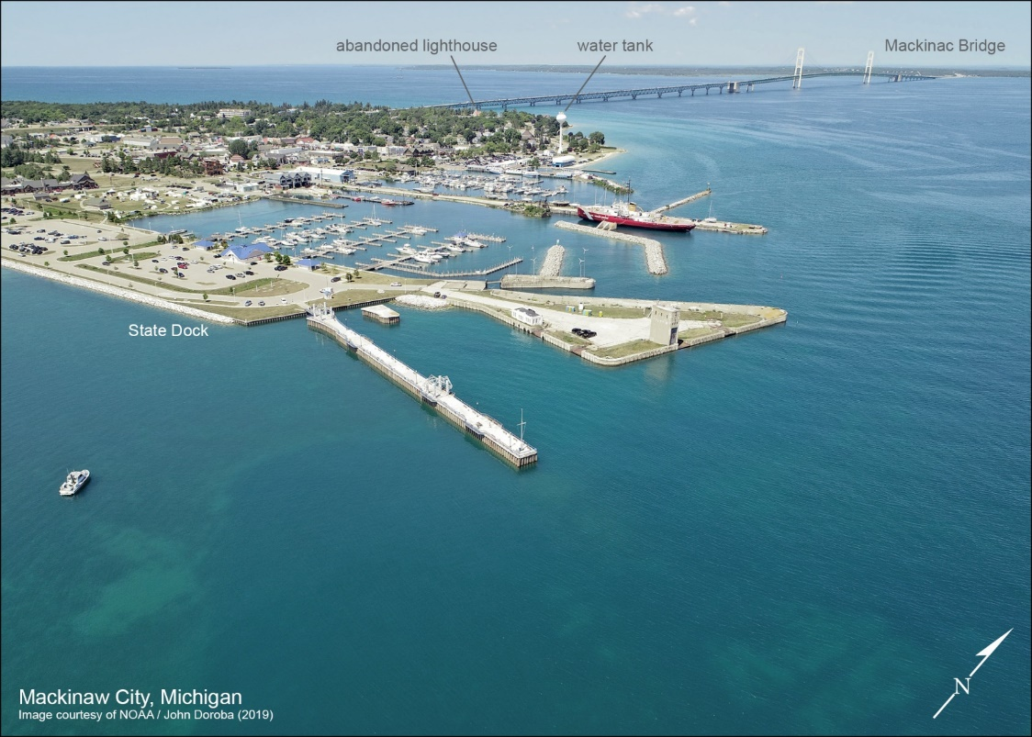
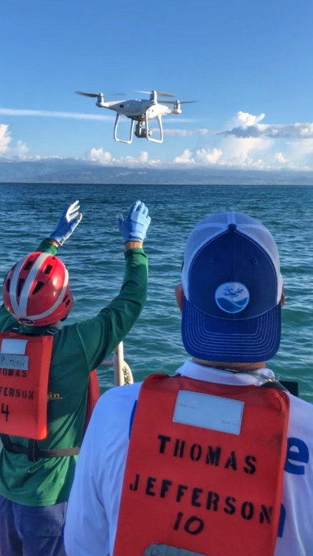
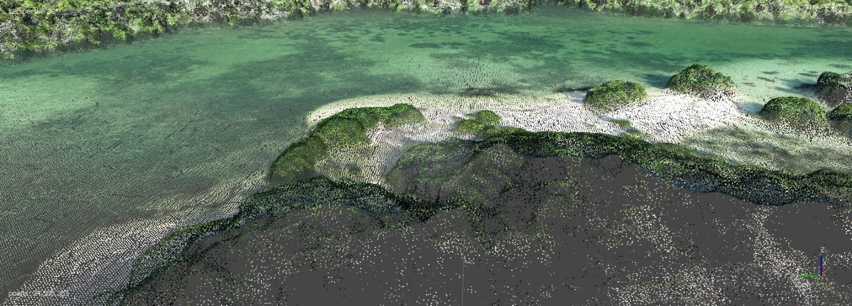
Shoreline via UAS
2019 Activities
Training program at NGS facility in Corbin, VA
Processing pipeline development
Operational Field use of UAS with NRT in Cheboygan, MI

Slide 5
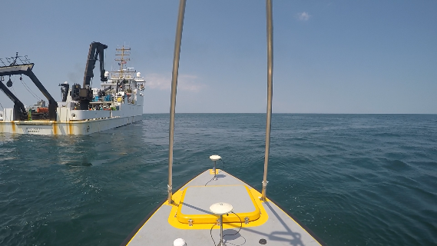

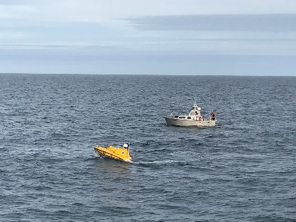
Shipboard USV Demonstrations
Habitat Mapping on Nancy Foster – 2016
Chartered ASV Global C-Worker 5
Collaboration with NCCOS
Coordinated surveys with the ship to explore operational concepts and shipboard requirements
Artic USV Survey – July 2018
UNH’s ASV C-Worker 4
Collaboration with UNH CCOM/JHC, NOAA Ship Fairweather
Tested new operational models, identified and solved technical short-comings, and provided experience to the ship’s crew in the operations and support of unmanned systems.

Slide 6
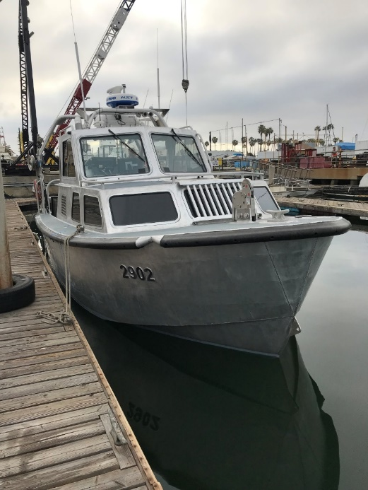
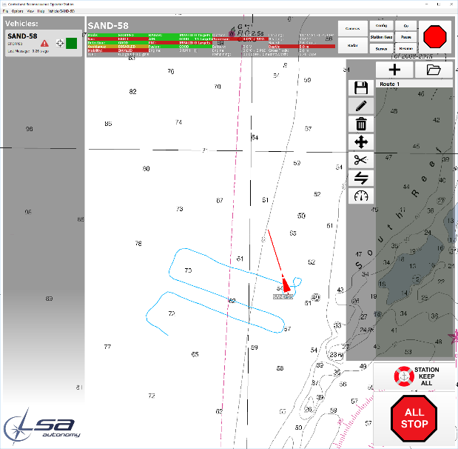
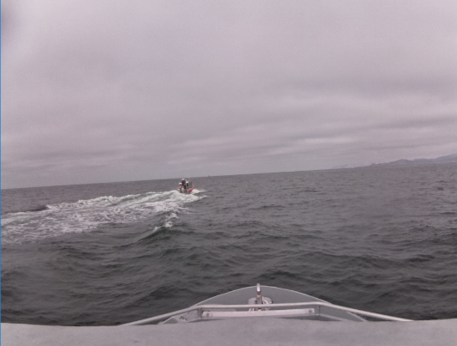
Recent Activities – Optionally Manned Survey Launch
Purpose
Maximize current infrastructure and expertise
Allow for expedited, moderately priced, and scalable means to integrate unmanned systems
Expected Benefits
Platform to develop and test enabling technologies & operational concepts
More effective use of survey personnel
Increased survey efficiency
Status
Feb 2019 – Technical Acceptance of 1st launch conversion on NOAA Ship RAINIER
Mar 2019 – Installation & Acceptance of 2nd launch conversion
Spring/Summer 2019 – At-sea operational testing

Slide 7
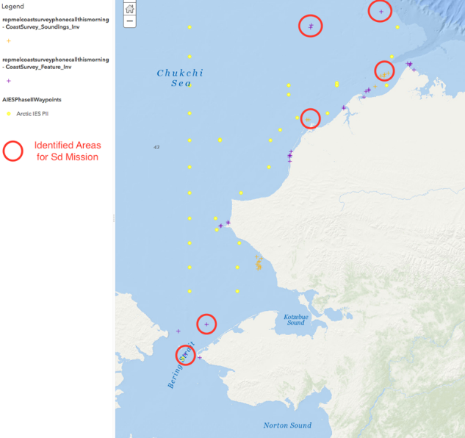
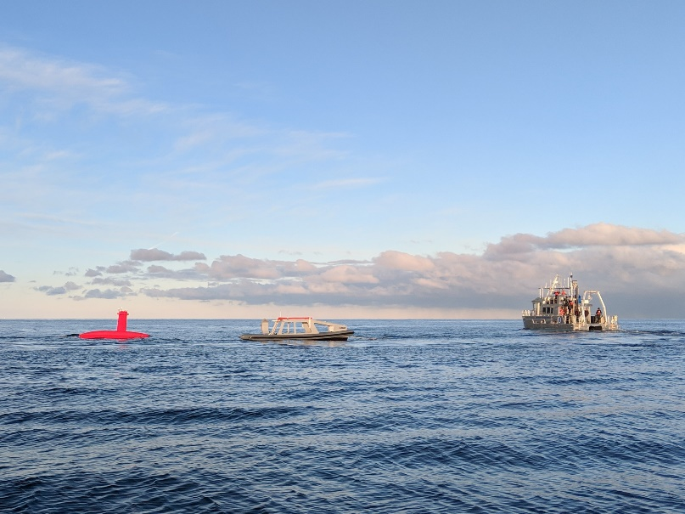
Collaborative Activities
SailDrone
Collaboration with NOAA PMEL
Opportunistic mapping to support charting efforts
Potential Missions – Reconnaissance, chart assessment, and investigation of chart discrepancies
UNH iXBlue DriX ASV
Testing and evaluation of the long endurance iXBlue DriX ASV through UNH’s industrial partners program
USM Saildrone Research
Testing and evaluation along the Gulf Coast to identify benefits to charting mission (cooperative agreement/grant)

Slide 8
Key Lessons Learned
Unmanned systems require the development of enabling technologies, such as automated data processing and high-bandwidth communications, that can also benefit manned operations.
Unmanned systems should provide new capabilities; one-for-one replacement of manned platforms in existing mission profiles is not effective.
Unmanned systems require skilled personnel to operate and maintain, and do not necessarily reduce staffing requirements, but can allow for the more effective use of personnel.

Slide 9
Key Lessons Learned
Unmanned systems do not diminish the need for ships, which may be necessary to deliver systems to remote locations and provide operational control and logistical support.
Unmanned systems require unique shipboard and land-based infrastructure, including launch and recovery systems (LARS), maintenance facilities, and communications, for their safe and effective operation.
Unmanned systems require supervision on a spectrum ranging from remote-controlled to fully autonomous depending on the environment and system capabilities.

Slide 10
Coast Survey UxS Vision
Develop and utilize unmanned systems for more efficient and effective acquisition of environmental data to support NOAA’s navigation products and services.

Slide 11
Strategy
Develop Enabling Technologies - Support the development and adoption enabling technologies to advance unmanned systems and benefit conventional manned operations.
Maintain Operational Expertise - Develop and maintain operational expertise with unmanned systems.
Operational Innovation - Support the development and transfer-to-operations of unmanned systems that benefit Coast Survey and NOAA missions.
Collaborate - Collaborate with government, academic, and industry partners to share expertise and resources and to direct and expedite system development.

Slide 12
Strategy
Develop Enabling Technologies
Activities - Software Development (Charlene, TensorScan), Data Radio Evaluation
2019 Goal - Reduce shipboard data processing effort 50% from 2017 level
Maintain Operational Expertise
Activities – UxS Operational Team in Stennis
2019 Goal – Team fully staffed and resourced to conduct Coast Survey and inter-disciplinary missions
Operational Innovation
Activities – Optionally-manned Launch Conversions
2019 Goal – Operational use of launch in unmanned configuration
Collaborate
Activities – SailDrone CRADA, USM and UNH partnerships
2019 Goal – Integration and operation of seafloor mapping sonar on SailDrone.

Slide 13
